Slide 1
Write a Servlet to demonstrate the difference between
HTTP GET and POST
methods by creating a form and handling requests accordingly.
AIM
To create a web application demonstrating the difference between HTTP GET and POST methods. The application includes a secure login gateway leading to a weather dashboard where users can search for city data and submit weather reports.
ALGORITHM
Input: User provides login credentials; once authenticated, they input city names for searching or weather feedback for submission.
Form Handling:
Create index.html using a POST form for secure login.
Create a dashboard with a GET form for city searches and a POST form for reporting conditions.
Servlet Processing:
LoginServlet: Authenticates credentials and redirects the user upon success.
WeatherServlet: Overrides doGet() to process searches via URL parameters and doPost()
to process report submissions via the request body.
Deployment: Compile the Servlets and deploy to a container like Apache Tomcat. Use
@WebServlet annotations or web.xml for URL mapping.
Output: Display processed results (City search result or submission confirmation) back to the browser.
SOURCE CODE
User Interface (index.html)
HTML
<!DOCTYPE html>
<html lang="en">
<head>
<meta charset="UTF-8">
<title>Login | Weather Portal</title>
<style>
body { margin: 0; font-family: 'Poppins', sans-serif; height: 100vh; display:
flex;
justify-content: center; align-items: center;
background: linear-gradient(43deg, #4158D0 0%, #C850C0 46%, #FFCC70
100%); }
.glass-card { background: rgba(255, 255, 255, 0.2); border-radius: 25px; padding: 40px;
text-align: center; color: white; backdrop-filter: blur(10px);
border: 1px solid rgba(255,255,255,0.1); width: 350px; }

Slide 2
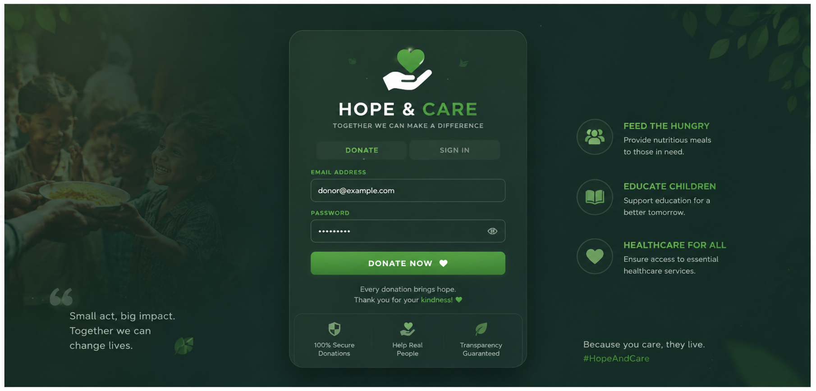
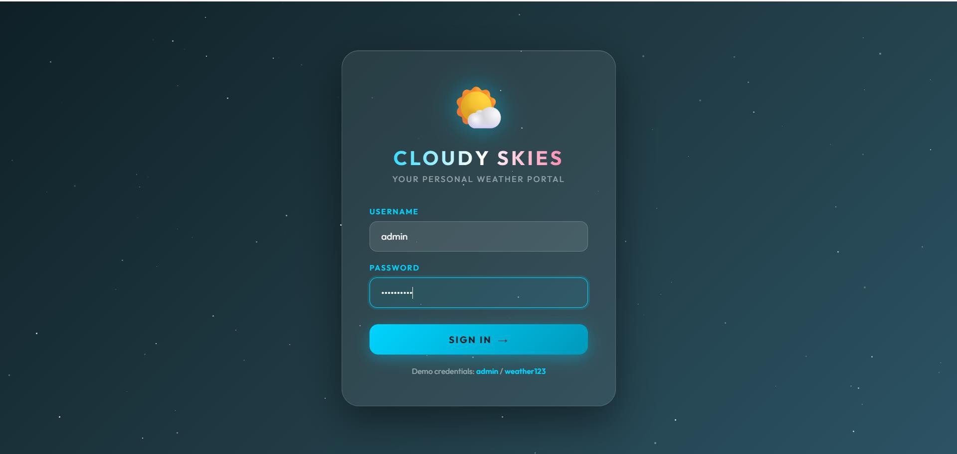
input { width: 100%; padding: 12px; margin-bottom: 15px; border-radius: 10px; border: none; }
.btn { width: 100%; padding: 12px; border-radius: 30px; border: none; background: #6c5ce7; color: white; font-weight: bold; cursor: pointer; }
</style>
</head>
<body>
<div class="glass-card">
<h1> ◆● Weather Login</h1>
<form action="LoginServlet" method="POST">
<input type="text" name="userid" placeholder="Username" required>
<input type="password" name="password" placeholder="Password" required>
<button type="submit" class="btn">Login</button>
</form>
</div>
</body>
</html>
Controller Servlet (LoginServlet.java)
Java
@WebServlet("/LoginServlet")
public class LoginServlet extends HttpServlet {
protected void doPost(HttpServletRequest request, HttpServletResponse response) throws ServletException, IOException {
String user = request.getParameter("userid");
String pass = request.getParameter("password");
if ("admin".equals(user) && "1234".equals(pass)) { response.sendRedirect("WeatherDashboard");
} else {
response.getWriter().println("<script>alert('Fail!'); window.location='index.html';</script>");
}
}
}
OUTPUT :

Slide 3
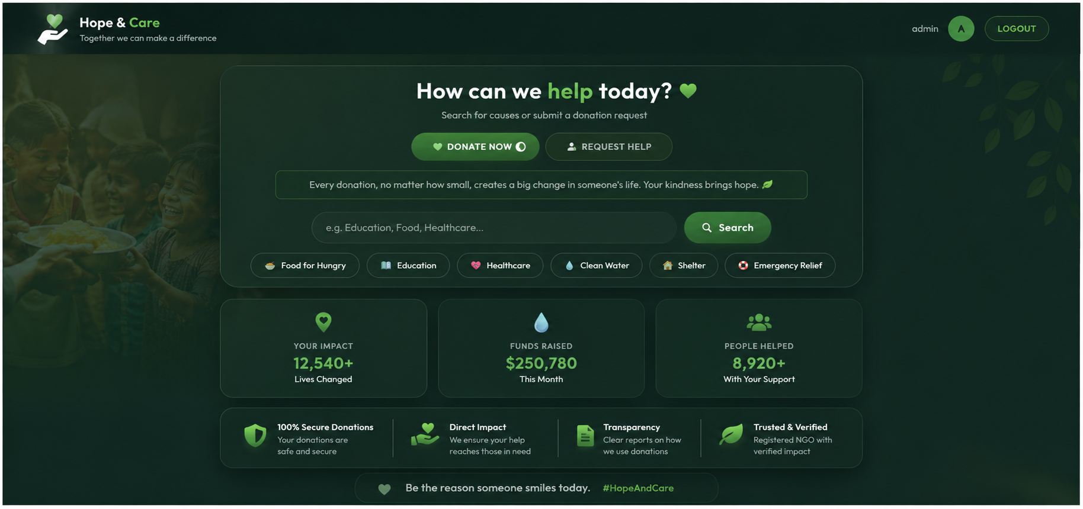
Get Method:
Post Method:

Slide 4
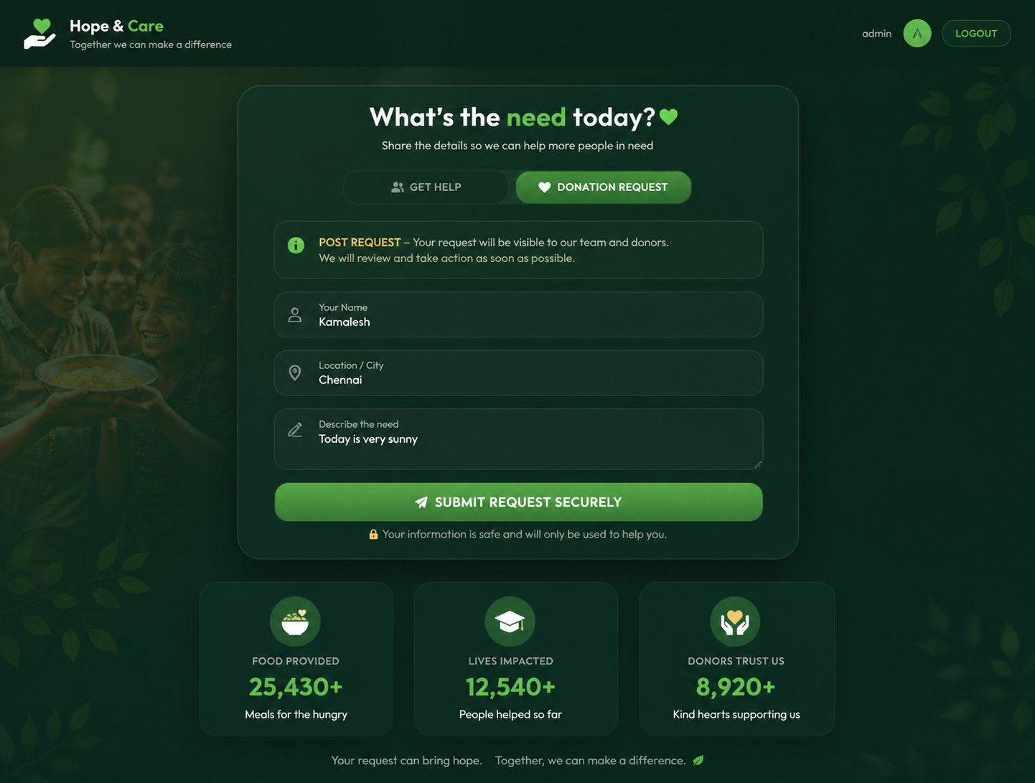
RESULT
A Servlet-based weather application was successfully created to demonstrate the differences between HTTP GET and POST methods. The GET method was utilized for data retrieval, while POST ensured secure data transmission for authentication and user reports.

